Slide 1
CGB1201 – JAVA PROGRAMMING
Department of Artificial Intelligence and Data Science
Academic Year: 2024 – 2025 (Odd Semester)
Register Number : 2303811724321115
Name : SURYA S
Year : II
Semester : III
Section : B
Date : 03-12-2024

Slide 2
Title of the Project
E-HEALTH MANAGEMENT SYSTEM

Slide 3
Problem Identification
Lost or Incomplete Patient Records: Mismanagement of patient health data can lead to errors in diagnosis and treatment.
Delayed Appointments: Difficulty in scheduling or keeping track of patient appointments.
Lack of Communication: Limited interaction between healthcare providers and patients outside of physical visits.
Data Privacy Concerns: The lack of a secure platform to manage health data, leading to potential breaches of confidential medical information.

Slide 4
Objective
The objective of the E-Health Management System is to:
Provide a centralized platform for managing health records, appointments, and services.
Ensure seamless communication between patients and healthcare providers.
Enhance the efficiency of medical operations, ensuring quick access to patient records and reducing errors.
Maintain secure management of patient data, complying with relevant data privacy regulations.
Provide features for real-time appointment scheduling, prescription management, and telemedicine capabilities.

Slide 5
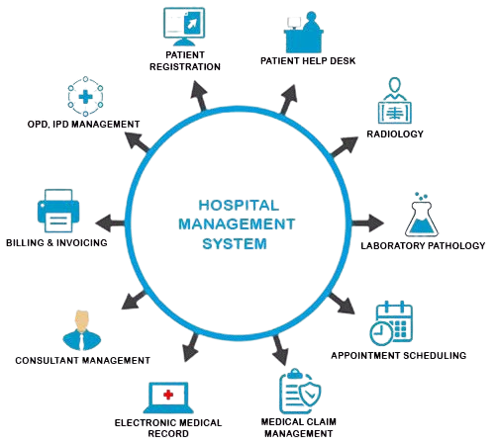
Proposed Architecture

Slide 6
Java Programming - Concepts Used
The development of EHMS utilizes a variety of Java programming concepts to implement core features and ensure high performance.
Object-Oriented Programming (OOP)
Exception Handling
Multi-threading
Logging Framework
Database Connectivity (JDBC)

Slide 7
List of Modules
Patient Registration
Patient Help Desk
OPD (Outpatient) Management
IPD (Inpatient) Management
Radiology Module
Laboratory and Pathology Management
Appointment Scheduling
Billing and Invoicing
Consultant Management
Electronic Medical Records (EMR)

Slide 8
Module Description
Patient Registration: Adds and manages patient details and medical history.
Patient Help Desk: Resolves patient queries and provides hospital-related info.
OPD Management: Handles outpatient visits and doctor consultations.
IPD Management: Manages patient admissions, room allocation, and discharge.
Radiology Module: Stores and accesses diagnostic images and reports.
Laboratory Management: Tracks lab tests, samples, and generates reports..

Slide 9
Module Description (Cont..)
Appointment Scheduling: Books, reschedules, or cancels patient appointments.
Billing and Invoicing: Calculates and generates bills for treatments and services.
Consultant Management: Manages doctor schedules and consultations.
Electronic Medical Records (EMR): Centralized digital storage of patient records.
Medical Claim Management: Processes and tracks insurance claims

Slide 10
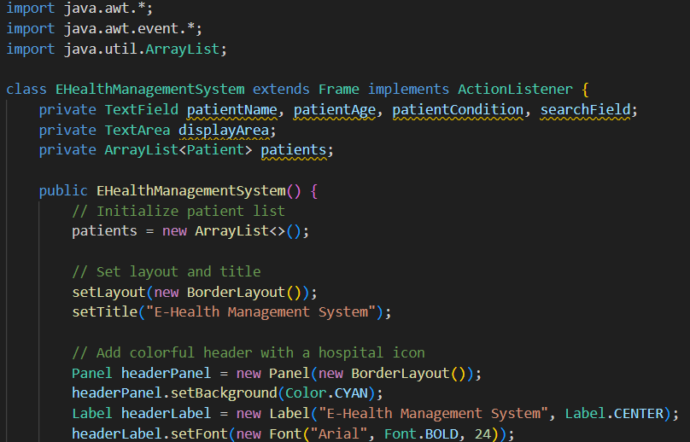
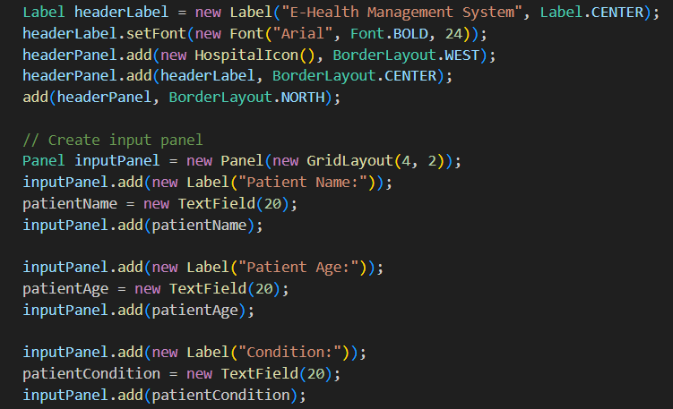
Source Code

Slide 11
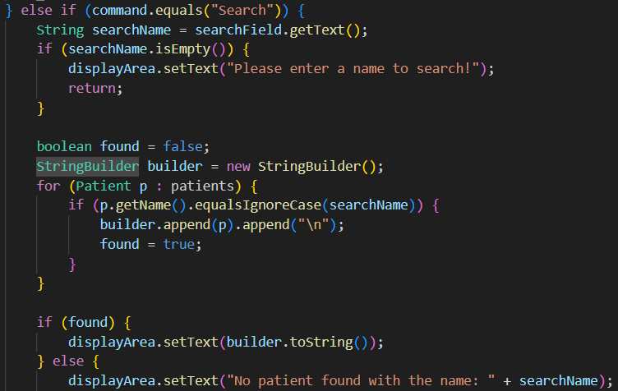
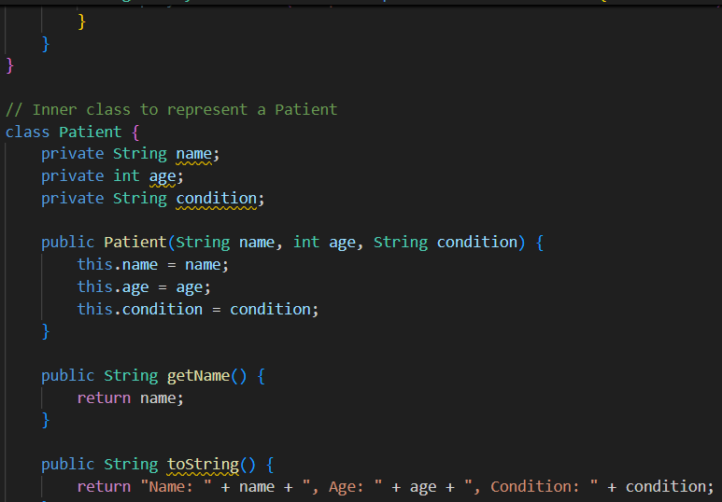
Source Code

Slide 12
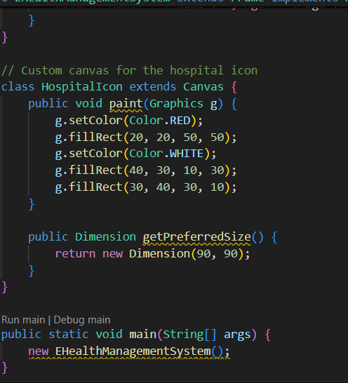
Source Code

Slide 13
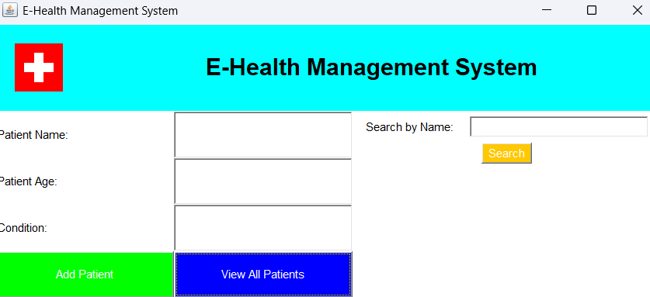
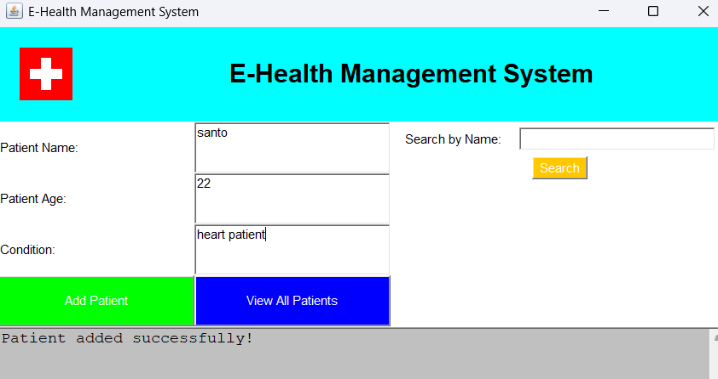
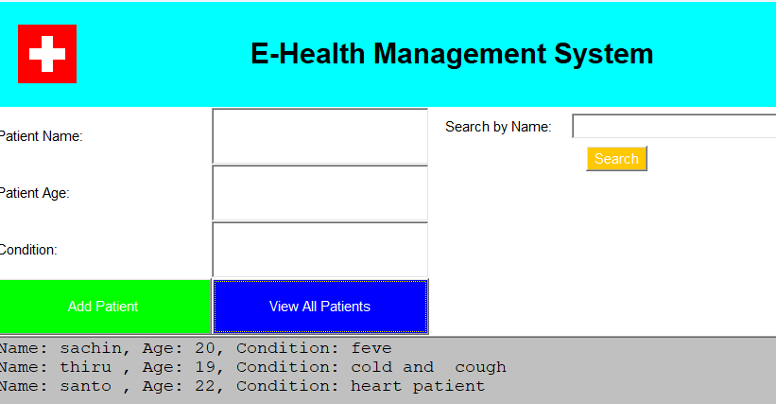
Results

Slide 14
Conclusion
The hospital management system helps hospitals run more smoothly by automating tasks, organizing patient data, and improving overall care. While it may be costly to set up and require staff training, the benefits, like saving time, improving communication, and making information easily accessible, make it worthwhile. The system can also grow with future technology, such as telemedicine and AI, to further enhance hospital operations and patient care.

Slide 15
Thank You
Any queries???

